Slide 1

IIT Roorkee PGCP DSML
Data Science Hackathon
December 21st & 22nd, 2021

Slide 2
Hack + Marathon = Hackathon
Hack is often defined as an inelegant but effective way to solve a problem

Slide 3
Hackathon Logistics
What is a Hackathon?
2-day team competition to solve a machine learning problem
Agenda for next 2 days
21st Dec – 10 am :: Kick-off and reveal of problem statement and dataset
21st Dec– 4:30 pm onwards :: Team-wise review session
22nd Dec– 10:00 am onwards :: Team-wise review session
22nd Dec– Midnight :: Deadline to submit presentations

Slide 4
Problem Statement
You are a data scientist at Megakkart the largest ecommerce platform in the country. Owing to the festive season Megakkart is planning a ‘Super Festive Sale’ where it wants to achieve a GMV sales of INR 500 crores. You are being provided with the user data for the past one year on various parameters mentioned below. You need to identify whether the user on the web portal will make a purchase or not. The company plans to work on various hooks for the customers who are at a risk of not making a purchase. Your analysis and machine learning model will help the product team to plan these hooks.

Slide 5
How to submit the solution for evaluation?
The dataset provided has three files
train.csv (labelled data) : training data with 40,000 records | 18 features | 1 target (Revenue)
test.csv (un-labelled data) : test data with 10,000 records | 18 features
sample_submission.csv (submission format) : – sample file to be used as template for submission of predictions
Teams need to submit the csv file along with predicted labels in the sample_submission.csv format
You can see/download Problem statement, data dictionary, datasets, leaderboard, submit the csv file along with predicted labels here.
The final Jupyter Notebook file along with any intermediate processed datasets & PPT/ Video (optional) in zip format can be submitted here

Slide 6
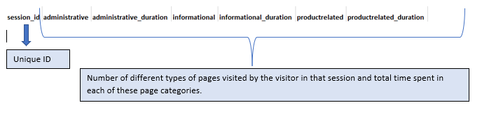
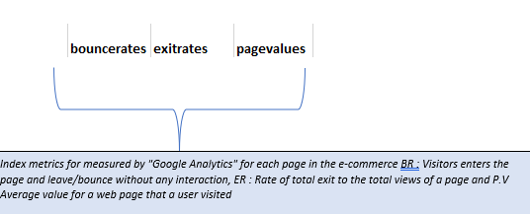
Data Description
Target variable

Slide 7
Evaluation #Leader board is not the only criteria of final evaluation
Each team will have submit their solutions in a PPT / PPT Video format
The teams will be evaluated on following
Exploratory data analysis and insights from the data (10 points)
F1 score of the model –Leaderboard score (10 points)
Presentation Skills (5 points)
At the end of the hackathon all teams need to submit
The final Jupyter Notebook file along with any intermediate processed datasets
Presentation Files & Video (if any)

Slide 8
Prizes
Winning Team
Amazon Gift Voucher worth INR 1,000/- for each team member
1st Runner Up
Amazon Gift Voucher worth INR 500/- for each team member
Certificate of participation to all
Best presentation will be uploaded to the Times TSW YouTube channel along with mention on a social media post.

Slide 9
Questions?

